Slide 1

Classification Model
K-Nearest Neighbor
Classifier

Slide 2



K-Nearest Neighbor Classifiers
Learning by analogy:
Tell me who your friends are and I’ll tell you who you are
A new example is assigned to the most common class among the (K) examples that are most similar to it.

Slide 3






K-Nearest Neighbor Algorithm
To determine the class of a new example E:
  Calculate the distance between E and all examples in the training set
  Select K-nearest examples to E in the training set
  Assign E to the most common class among its K-nearest neighbors
Response
No response
No response
Class: Response
No response
Response

Slide 4
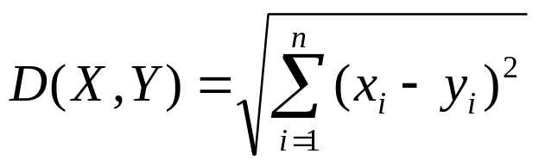
K-Nearest Neighbor Classifier
Distance Between Neighbors
Each example is represented with a set of numerical attributes
“Closeness” is defined in terms of the Euclidean distance between two examples.
  The Euclidean distance between X=(x₁, x₂, x₃,…x_{n}) and Y =(y₁,y₂, y₃,…y_{n}) is defined as:
  Distance (John, Rachel)=sqrt [(35-41)²+(95K-215K)² +(3-2)²]
  John:
  Age=35
  Income=95K
  No. of credit cards=3
  Rachel:
  Age=41
  Income=215K
  No. of credit cards=2

Slide 5
K-Nearest Neighbor: Instance Based Learning
No model is built: Store all training examples
Any processing is delayed until a new instance must be classified.
Response
No response
No response
Class: Respond
No response
Response

Slide 6
Example : 3-Nearest Neighbors
K-Nearest Neighbor Classifier
Customer | Age | Income | No. credit cards | Response
John | 35 | 35K | 3 | No
Rachel | 22 | 50K | 2 | Yes
Hannah | 63 | 200K | 1 | No
Tom | 59 | 170K | 1 | No
Nellie | 25 | 40K | 4 | Yes
David | 37 | 50K | 2 | ?

Slide 7
K-Nearest Neighbor Classifier
Example
Customer | Age | Income (K) | No. cards
John | 35 | 35 | 3
Rachel | 22 | 50 | 2
Hannah | 63 | 200 | 1
Tom | 59 | 170 | 1
Nellie | 25 | 40 | 4
David | 37 | 50 | 2
Response
No
Yes
No
No
Yes
Distance from David
sqrt [(35-37)²+(35-50)² +(3-2)²]=15.16
sqrt [(22-37)²+(50-50)² +(2-2)²]=15
sqrt [(63-37)²+(200-50)² +(1-2)²]=152.23
sqrt [(59-37)²+(170-50)² +(1-2)²]=122
sqrt [(25-37)²+(40-50)² +(4-2)²]=15.74
Yes

Slide 8
K-Nearest Neighbor Classifier
Strengths and Weaknesses
Strengths:
Simple to implement and use
Comprehensible – easy to explain prediction
Robust to noisy data by averaging k-nearest neighbors.
Some appealing applications (will discuss next in personalization)
Weaknesses:
Need a lot of space to store all examples.
Takes more time to classify a new example than with a model (need to calculate and compare distance from new example to all other examples).

Slide 9
K-Nearest Neighbor Classifier
Classification Tree Modes
K-Nearest Neighbors
Age > 40
No
Yes
Class=No
Response
Income>100K
Yes
No
Response
No response
No
response
No
Response
No cards>2
Yes
No
Response
Class: Response
No response
Response
No
Response

Slide 10
Strengths and Weaknesses K-Nearest Neighbor Classifier
  John:
  Age=35
  Inco me=95K
  No. of credit cards=3
  Rachel:
  Age=41
  Income=215K
  No. of credit cards=2
Distance (John, Rachel)=sqrt [(35-45)²+(95,000-215,000)² +(3-2)²]
Distance between neighbors could be dominated by some attributes with relatively large numbers (e.g., income in our example). Important to normalize some features (e.g., map numbers to numbers between 0-1)
Exmaple: Income
Highest income = 500K
Davis’s income is normalized to 95/500, Rachel income is normalized to 215/500, etc.)

Slide 11
Strengths and Weaknesses K-Nearest Neighbor Classifier
Normalization of Variables
Customer | Age | Income (K) | No. cards
John | 55/63= 0.55 | 35/200= 0.175 | ¾= 0.75
Rachel | 22/63=0.34 | 50/200= 0.25 | 2/4= 0.5
Hannah | 63/63= 1 | 200/200=1 | ¼= 0.25
Tom | 59/63= 0.93 | 170/200=0.85 | ¼= 0.25
Nellie | 25/63= 0.39 | 40/200= 0.2 | 4/4= 1
David | 37/63= 0.58 | 50/200= 0.25 | 2/4= 0.5
Response
No
Yes
No
No
Yes
Yes

Slide 12
Strengths and Weaknesses K-Nearest Neighbor Classifier
Distance works naturally with numerical attributes
D(Rachel&Johm)= sqrt [(35-37)²+(35-50)² +(3-2)²]=15.16
What if we have nominal attributes?
Example: married
Customer | Married | Income (K) | No. cards
John | Yes | 35 | 3
Rachel | No | 50 | 2
Hannah | No | 200 | 1
Tom | Yes | 170 | 1
Nellie | No | 40 | 4
David | Yes | 50 | 2
Response
No
Yes
No
No
Yes

Slide 13
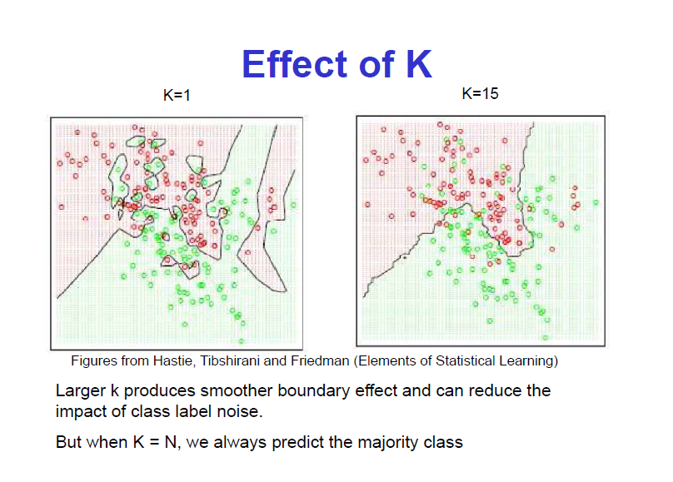

Slide 14
Pustaka
Dari berbagai sumber online

Slide 15
Tugas - 2
Mempelajari algoritme modifikasi dari KNN
Jelaskan algoritmenya
Berikan contoh pengujian menggunakan data yang sedikit disertai cara perhitungannya
Tugas kelompok berdasar urut NIM
Tiap kelompok terdiri dari 10 mahasiswa
Dikumpulkan kamis 25 September 2014 berupa hardcopy jam 15.00 (maksimum)
Tidak boleh ada algoritme yang sama

